Slide 1
Project Title :
Shout Box

Slide 2
Team members :
SHUBHAM BORSE 23342
KETKI GOVILKAR 23343
PRANITA BHOSALE 23344
YOGESH CHINTAWAR 23345
NEHAL KULKARNI 23346

Slide 3
Contributions :
1.Yogesh (23345)
Register functionality
User can accept & reject friend request.
Search any user
Add friend , remove friend & block any user.
2.Nehal (23346)
Login & Logout Functionality.
JWT Authentication.

Slide 4
Authorization at frontend.
Shouts API : can see his own and his friends shouts.
Can upload shouts as Text , Images , Audio & Videos.
User can see shouts.
3.Shubham (23342)
Timeline page functionalities.
Search bar functionality.
4.Ketki (23343)
Registration with validations .
Edit Profile with validations.

Slide 5
5.Pranita (23344)
Login page with validations.
User profile page where user can see his own shouts , sent request , can see incoming request.
Logout Functionality.

Slide 6
Introduction :
In this project , we have developed an application named “ Shout Box ” , the social media application. The main objective of this application is to share the posts with our friends online. This website gives you a nice experience while sharing your posts with your friends. For using this application user needs to register first or if register, then have to login from login page. The successful login takes the user on the next page , which is user timeline page where he is able to see the posts made by his friends he can make comments on there posts & after clicking on user profile button user can see his friends list , shouts , timeline ,follow requests that he got. In edit profile the user can upload a profile picture, change profile picture and can edit his data.

Slide 7
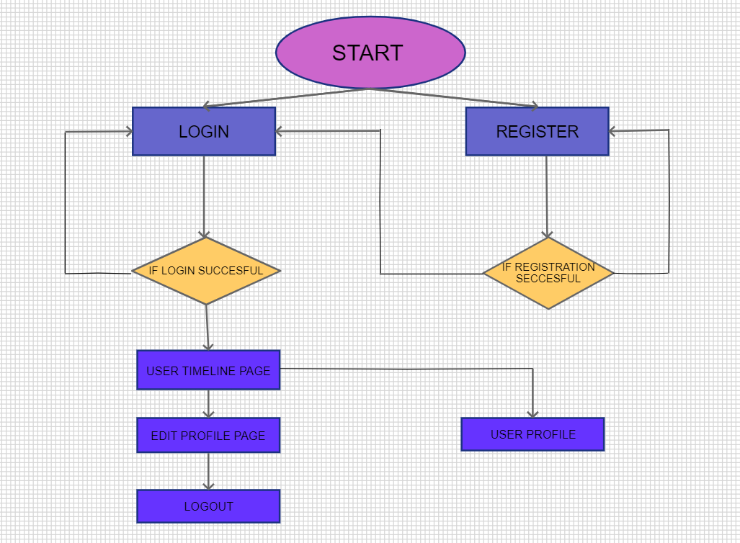
FLOW DIAGRAM :

Slide 8
Let’s Take A Overview Of “ Shout Box ” .

Slide 9
A. User Register & Login Page :
Scope of project :
In this project, there are multiple pages to perform operations like Login, Registration, Edit profile , Timeline , Friend Request , Delete Request , etc. The complete scope of the project is as follows :
- User Register page allows user to register into the system.
If user is already registered, he can login into the system with valid email & password.
In case of invalid credentials, page shows the alert message telling user that he has entered invalid password or email.

Slide 10
B. User Timeline Page
Where user is able to upload the posts as well as he can see the posts made by his friends he can make comments on there posts .
User can search his friends by their user names.
C. Edit Profile
- In edit profile page he can edit his personal information like his first name ,last name , mobile number and password .
- User can upload a profile picture, change profile picture.

Slide 11
D. User Profile Page :
On user Profile Page ,user can see his own shouts , friend list ,pending friend requests Sent Requests , Timeline.
User can block the friends , can unfriend the respective person , can decline friend request
User can delete his own shouts.

Slide 12
Technologies used :
To developed the front-end of our application we used framework Angular along with Bootstrap, SASS ,RWD etc.
For back-end we used a python framework Django.
We used SQLite as our database.
We used git as a version control system.
We used VS Code extension “ Prettier ” for code indentation.

Slide 13
Thank You.

